Slide 1
SVM Regression

Slide 2
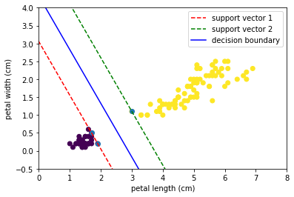
SVM Regression
Classification
“Keep the street wide & clean”
Notes:
Photo: https://www.flickr.com/photos/107442568@N08/12547327134

Slide 3
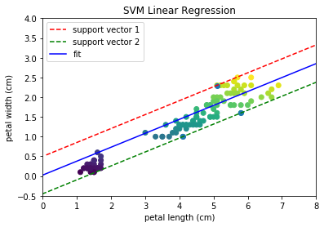
SVM Regression
Regression
Get the street as narrow as possible and try to fit as many instances within it
Notes:
Photo: https://www.flickr.com/photos/107442568@N08/12547327134

Slide 4
SVM Regression
Regression
Get the street as narrow as possible and try to fit as many instances within it
Width controlled by epsilon,
larger = larger street
squared-epsilon insensitive loss
Notes:
Photo: https://www.flickr.com/photos/107442568@N08/12547327134

Slide 5
SVM Regression
Additional Parameter
Shrinking - can help improve training times when model has many iterations by effectively removing some observations during training that likely won’t contribute to the loss.
Not as effective though as e.g. just making error tolerance larger
Notes:
Photo: https://www.flickr.com/photos/107442568@N08/12547327134

